Slide 1

Haoma Mining NL
Welcome to
Haoma Mining NL
Annual General Meeting
Of Shareholders
Wednesday
November 26, 2025

Slide 2
Haoma Mining NL
CHAIRMAN’S PRESENTATION TO SHAREHOLDERS
By Gary Morgan,
Wednesday November 26, 2025

Slide 3
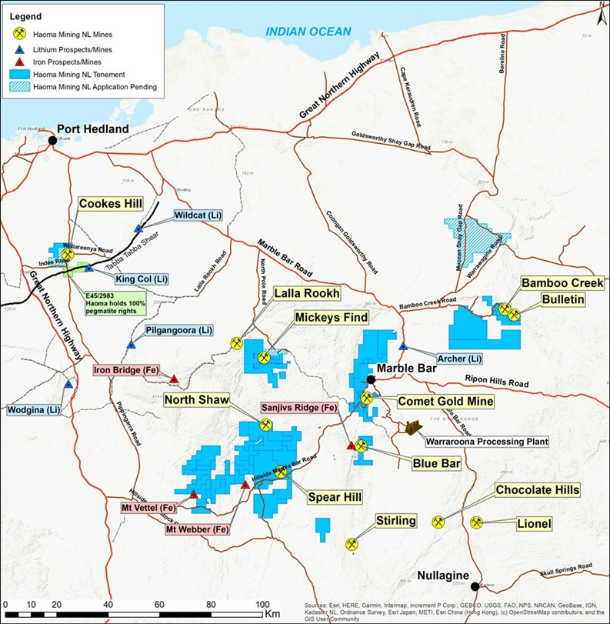
Haoma Mining NL
Slide 1
Figure 1: Location map of Haoma Mining’s Pilbara exploration and mining tenements and the locations of Pilbara ores used in Haoma’s test work

Slide 4
Haoma Mining NL
Financial results
Major Pilbara activities
Resources
Research and Development
BHP Drilling
Rare Earth Review
Pirra Lithium
Questions

Slide 5
Haoma Mining NL
Slide 2

Slide 6
Haoma Mining NL
HAOMA’S MAJOR PILBARA ACTIVITIES

Slide 7
Haoma Mining NL
Slide 3
Haoma’s Major Pilbara Activities
The Bamboo Creek Pilot Plant is now processing Gravity Concentrate from Bamboo Creek Tailings and has produced bullion.
The move from laboratory to production is always interesting. After some ‘experimentation’ we are now using a simplified Elazac Process to produce a Concentrate of 110+g/t gold and a 97% gold button, representing 2.55g/t back to the Bamboo Creek Tailings.
Along the way we have found significant PGM (%s) in the Concentrates recovered.

Slide 8
Haoma Mining NL
Slide 4
Haoma’s Major Pilbara Activities – work with Dr Peter Scales

Slide 9
Haoma Mining NL
Slide 5
Haoma’s Major Pilbara Activities
Over the last two weeks, Trials using the Bamboo Creek Plant have resulted in significant quantities of gold, PGM, and other metals being measured by XRF in Concentrates recovered from about 2% of Bamboo Creek Tailings, and precious metal grades like those measured Dr Peter Scales in Table 2 below.

Slide 10
Haoma Mining NL
HAOMA’S RESOURCES
Haoma’s leases are all in good standing

Slide 11
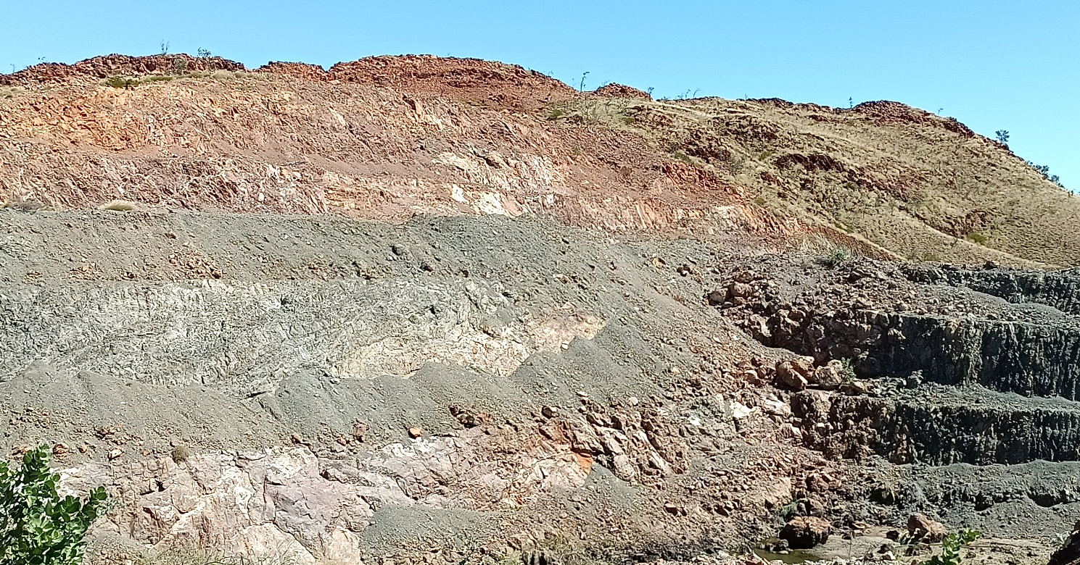
Haoma Mining NL
Haoma’s Mineral Resource Estimates
Slide 6
At Bulletin Mine a Maiden Probable Ore Reserve reported by Calidus according to the 2012 JORC Code of 600,000t @ 2.86g/t Au for 55,000oz that includes an open pit Inferred Resource of 100,000t @ 2.55g/t Au for 8,000oz. The estimated total ‘in ground’ value, while remaining open at depth is $404+m (November 13, 2025, gold price $A6,420/oz).
Bulletin Deposit looking southwest at the south and western walls.

Slide 12
Haoma Mining NL
Haoma’s Mineral Resource Estimates
Slide 7
Blue Bar Pit showing water in the pit covering remaining ore.

Slide 13
Haoma’s Mineral Resource Estimates
Haoma Mining NL
Slide 8
At Copper Knob, Ravenswood, Qld, Haoma’s 2024 drilling of the resource confirmed a previously measured mineral resource estimate of 620,000t @ 1.04 g/t Au to a vertical depth of up to 25m. Further drilling is required to convert the mineral resource for reporting under the 2012 JORC Code. If the mineral resource remains consistent, the estimated ‘in-ground’ value may be close to $133+m (November 13, 2025, gold price $A6,420/oz).

Slide 14
Haoma’s Mineral Resource Estimates
Haoma Mining NL
Slide 9
At Mickey’s Find, an estimated 11,805,000t @ 1.02 g/t for 386,300oz was reported according to the 2004 JORC Code. Further drilling is required to convert the mineral resource for reporting under the 2012 JORC Code. If the mineral resource remains consistent, the estimated total ‘in ground’ value may be close to $2.4+b (November 13, 2025, gold price $A6,420/oz)
Mickey’s Find estimates that relate to Mineral Resources is based on information compiled and reported previously in accordance with the Australasian Code for Reporting of Mineral Resources and Ore Reserves, 2004 Edition (JORC 2004). These estimates have not been updated to comply with the JORC Code 2012 as the information has not materially changed since last reported. A Competent Person has not done sufficient work to classify the historical estimates as Mineral Resources or Ore Reserves in accordance with the JORC 2012 Code. It is possible that following evaluation and/or further exploration work the accuracy or classification of the estimates may change and therefore, the historical estimates should not be relied upon as JORC 2012 Mineral Resources or Ore Reserves. Nothing has come to the attention of the Haoma that causes it to question the accuracy or reliability of the historical JORC 2004 estimates, but the Company has not independently validated the data to JORC 2012 reporting standards. Haoma is not aware of any new information or data that materially affects the information included in the original market announcement and, in the context in which it appears, the supporting information in the original announcement continues to apply and has not materially changed.

Slide 15
Haoma Mining NL
RESEARCH AND DEVELOPMENT

Slide 16
Physical gold recovered from Pilbara ore at the Bamboo Creek Plant
Haoma Mining NL
Slide 10
In July 2025, 492.8 tonnes of <3mm from Haoma’s ore (Sample 1403000 – comprising approximately a third each of Bamboo Creek Tailings, Kitchener Low-grade Ore, and fines from Haoma’s Mt Webber Dump Ore) was beneficiated through the Bamboo Creek Pilot Plant to produce 221.8 tonnes of < 0.85-micron ore (Bamboo Creek Plant Fines).

Slide 17
Haoma Mining NL
Slide 11
Physical gold recovered from Pilbara ore at the Bamboo Creek Plant

Slide 18
Physical gold recovered from Pilbara ore at the Bamboo Creek Plant
Haoma Mining NL
Slide 13

Slide 19
Physical gold recovered from Pilbara ore at the Bamboo Creek Plant
Haoma Mining NL
Slide 14
Physical gold recovered from processing Bamboo Creek Tailings

Slide 20
Physical gold recovered from Pilbara ore at the Bamboo Creek Plant
Haoma Mining NL
Slide 15
Physical Gold measured in a Gravity Concentrate recovered from processing Bamboo Creek Tailings through the Bamboo Creek Plant
In addition, trial test-work was conducted with Gravity Concentrate of the Bamboo Creek Tailings to see if this improved the gold recovery - to determine if the quantity of physical gold per tonne processed was higher using only Gravity Concentrate rather than entire Bamboo Creek Tailings (as above).
The calculated Bamboo Creek Tailings gold grade for each Sample was 2.23g/t and 1.50g/t, resulting in 3.73g/t gold recovered from Bamboo Creek Tailings Gravity Concentrate (2.35% of the Bamboo Creek Tailings).
Although 3.73g/t gold recovered means not all the gold was recovered (estimated 30.05g/t), there is immediate value in now processing a small proportion of the tailings through the Pilot Plant, to achieve 3.73g/t - inexpensively. See Table 2 above for grades of gold and PGM in BBC Concentrates.

Slide 21
Haoma Mining NL
BHP DRILLING IN 1996

Slide 22
Samples collected by BHP from their 1996 drilling program
Haoma Mining NL
Slide 16

Slide 23
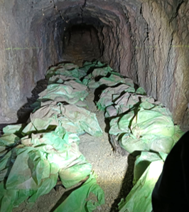
Haoma Mining NL
Slide 17
Samples collected by BHP from their 1996 drilling program
Samples from BHP drill-holes stored in the Perseverance Mine shaft since 1996.

Slide 24
Haoma Mining NL
Slide 18
Photographs of interval samples from BHP drill-holes CF2, CF12, QCS1 and BS1.
Initial XRF readings of the samples below show they contain gold, PGM, other metals plus Heavy Rare Earths (HREE) in carbonatites, containing 0-5% iron.

Slide 25
Haoma Mining NL
HAOMA’S RARE EARTH REVIEW.
We urge you to read the document.

Slide 26
Haoma Rare Earths Overview
Haoma Mining NL
Slide 19

Slide 27
Haoma Rare Earths Overview
Haoma Mining NL
Slide 20

Slide 28
Haoma Mining NL
PIRRA LITHIUM
JV BETWEEN HAOMA & SQM

Slide 29
Pirra Lithium Pty Ltd – Exploration Joint Venture between Haoma Mining and SQM Australia.
Haoma Mining NL
Slide 21
A nine-day, helicopter-supported reconnaissance campaign was undertaken during the 2025 winter field season, visiting over 250 target locations and collecting more than 200 samples. Targeting focused on key structural features - including the fold hinge in the northwest, the central structural corridor, and the eastern granite contact zone (extending from the 2024, E45/4320 reconnaissance).
Overall, the Daltons/Mt Webber Project remains highly prospective for LCT (Lithium–Caesium–Tantalum) pegmatites, supported by multi-element anomalism and structural-lithological indicators consistent with spodumene systems.

Slide 30
Haoma Mining NL
ELAZAC QUARRY

Slide 31
Hard Rock sales from Elazac Quarry, Cookes Hill (M45/1186)
Haoma Mining NL
Slide 22

Slide 32
Haoma Mining NL
TOP CAMP IN QUEENSLAND

Slide 33
Haoma Mining NL
Slide 23
Haoma’s Top Camp Road-House & Caravan Park, Ravenswood, Queensland
The roadhouse shop provides an extensive range of services to the local community and visitors to the area.

Slide 34
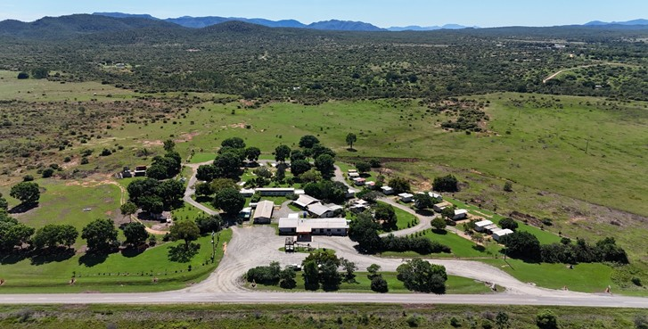
Haoma Mining NL
Slide 24
Haoma’s Top Camp Road-house and Caravan Park, Ravenswood, Queensland

Slide 35
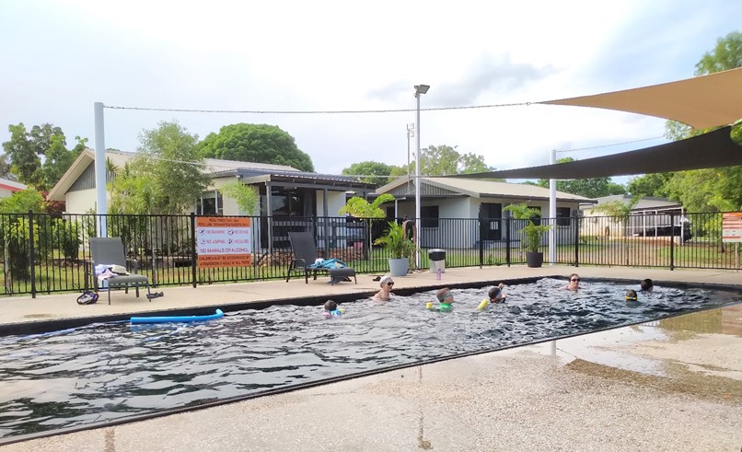
Haoma Mining NL
Slide 25
Top Camp swimming pool, housing accommodation in the background.

Slide 36
Haoma Mining NL
Acknowledgements:
Haoma is now processing Bamboo Creek ore and can commercially produce gold.
The Directors wish to acknowledge and express their appreciation to all those who during the last year have contributed to the company’s activities in the Pilbara and Ravenswood districts. In particular, the Board’s thanks go to Mr. Peter Cole, Prof. Peter Scales, Mr. Hugh Morgan, Mr. Vern Cook, Mr Peter Williams, Mr John McInnes and other consultants who have contributed to help Haoma solve the gold, silver and Platinum Group Metals (PGM) assay problem associated with Pilbara ores; and the extraction of gold, silver, PGM and other metals from Pilbara ores.
The Board also acknowledges the significant efforts of those personnel working at the remote Pilbara and Ravenswood operations. These people include Tristin Cole, Darren Brookes, Ryan Lowery, Lee-Anne Guy and Julie Peckham at Bamboo Creek, Philip Newcombe at the Comet Gold Mine and Tourist Centre, Colin Derrell at the Normay Gold Mine and our managers at Top Camp, Ravenswood, Pattyie and Ewan Johnstone.
I personally thank my fellow Directors, Michele Levine, Tim Ingram, Edwin van Leeuwen and Robert Annells and Company Secretaries, Jim Wallace and Xenia Holmes for all they have done over the last 12 months – they, and all people mentioned above, are responsible for this Haoma Annual Report.
Slide 26

Slide 37
Haoma Mining NL
QUESTIONS

Slide 38
Haoma Mining NL
Thank you for attending today’s Haoma AGM
Please join us for refreshments and discussion on this presentation
END

Slide 39
Haoma Mining NL

